Slide 1

Exploring the Potential of GANs, LSTM, and VAEs in Advancing Music Generation Paper Id:151
ICDSMLA-23
Nagireddy Moneesh
Department of Computer Science and Engineering
Amrita Vishwa Vidyapeetham, Kollam,Kerala ,India
5th International Conference on Data Science, Machine Learning & Applications

Slide 2
Objective Introduction Literature Review Dataset Methodology Results and Discussions Conclusion References
Presentation Contents

Slide 3
Computer-Generated Music Evaluation: Methods used for exploration: LSTMs, GANs, VAE Analogy: GANs: Creative collaboration resembling two friends—one creating, the other judging. LSTMs: Memory reservoir preserving essence for inspiration in new compositions. VAEs: VAEs: Musical blender expertly blending song fragments for new compositions. Main Goal: Identify the most enjoyable musical result among GANs, LSTMs, and VAEs.
OBJECTIVE

Slide 4
INTRODUCTION
Gan:
Generative Adversarial Networks (GANs) represent a groundbreaking development in artificial intelligence, specifically in creative tasks such as music generation.
Operating through dual neural networks—the generator and discriminator—GANs engage in a continuous tug-of-war, refining the generator's capacity to craft music that closely emulates human compositions.
This dynamic process introduces a distinctive palette for music creation, yielding novel melodies and rhythms that seamlessly blend human ingenuity with algorithmic intricacy.
Beyond technicalities, GANs hold transformative potential, redefining the landscape of music automation by positioning technology as a collaborative force in the creative process, reshaping our perception and experience of musical artistry in the digital era.

Slide 5
INTRODUCTION
LSTMs:
Long Short-Term Memory networks (LSTMs) are a significant innovation in artificial intelligence, specifically designed for sequential data processing.
Serving as memory reservoirs, LSTMs excel in retaining the essence of previous musical compositions, providing inspiration and guidance for the creation of new harmonious pieces.
Their strength lies in the ability to capture and learn complex patterns in data sequences, making them particularly adept at understanding nuanced relationships in music.
In the context of computer-generated music, LSTMs play a crucial role in evolving harmonies and ensuring coherence across different segments of a musical piece.

Slide 6
INTRODUCTION
VAEs:
Variational Autoencoders (VAEs) represent a significant advancement in artificial intelligence, particularly in the domain of generative modeling.
VAEs are structured to learn and generate new data points by capturing the underlying distribution of the input data.
Unlike traditional autoencoders, VAEs introduce a probabilistic element, enabling them to produce diverse and realistic outputs.
In the context of computer-generated music, VAEs act as expert blenders, seamlessly combining song fragments to create entirely new and melodic compositions.
Their ability to interpolate between different data points allows for the generation of music with a smooth and coherent transition between styles and elements.

Slide 7
Shah, Falak explains As availability of high computing power and the evolution of deep learning architecture the model could easily learn from music sequential data. Used Google Magenta’s inbuilt model and Long Short Term Memory model. (first in references page) A. Maduskar explains Autoregression models will generate iterative subsampling will results in generating localized music level. (second) J. Tang explains the revolutionary of transformer models in the creation of music.(Third) J. Wang study indicates the problem of composing computer generated jazz music while attempting to conform created music to align generated music with established music rules. (Fourth) S. Sajad explains recurrent neural network to generate melodious pieces of music. (Fifth)
LITERATURE REVIEW

Slide 8
DATASET
1. Introduction to GTZAN Dataset.
Overview of the GTZAN Dataset created by Andrada Olteanu.
2. Purpose and Notability.
Designed for music genre classification, it is a notable resource in the field of music analysis.
3. Dataset Characteristics.
Emphasis on its substantial size, indicating a comprehensive collection covering multiple music genres.
4. Data Structure.
Describes the dataset structure, likely consisting of rows representing individual music tracks and columns capturing 111various features like tempo, rhythm, and melodic patterns.
5. Contributions to the Community.
Acknowledges Andrada's contribution to the research community, providing a rich resource for in-depth exploration of 111music genres and their classification.

Slide 9
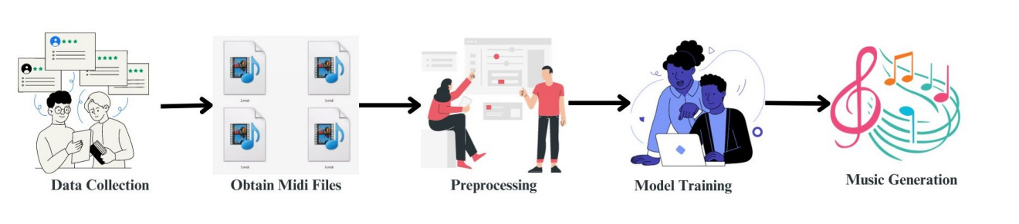
METHODOLOGY

Slide 10
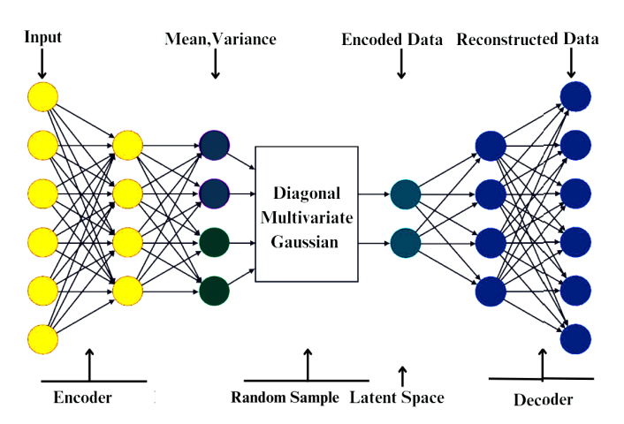
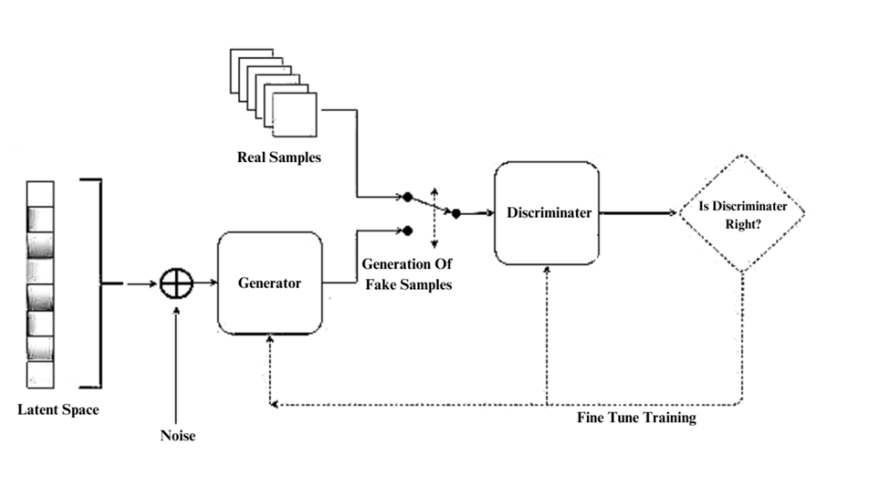
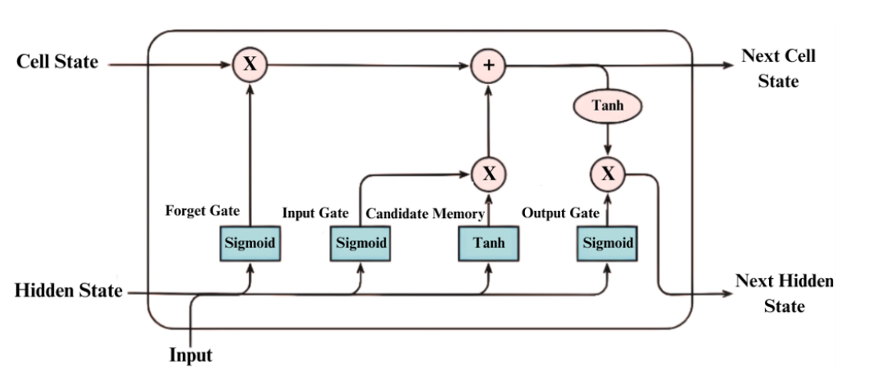
METHODOLOGY
LSTM
GAN
VAE

Slide 11
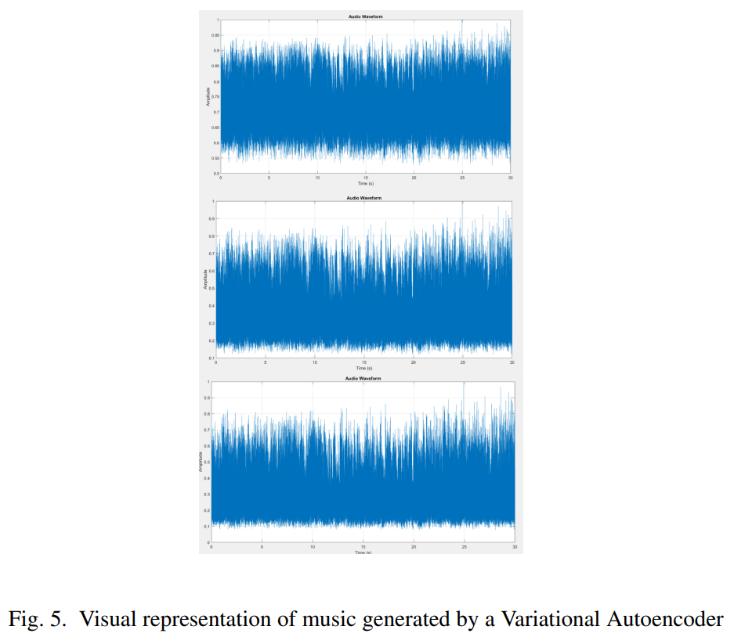
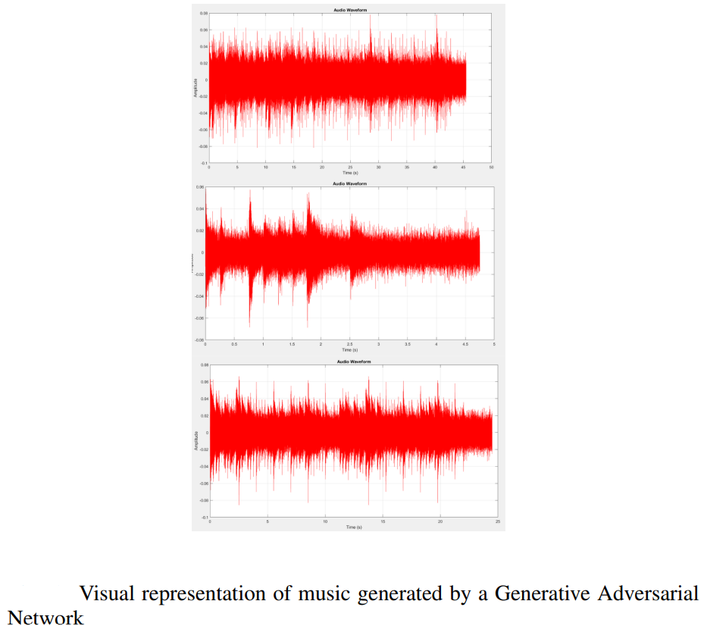
RESULTS AND DISCUSSIONS

Slide 12
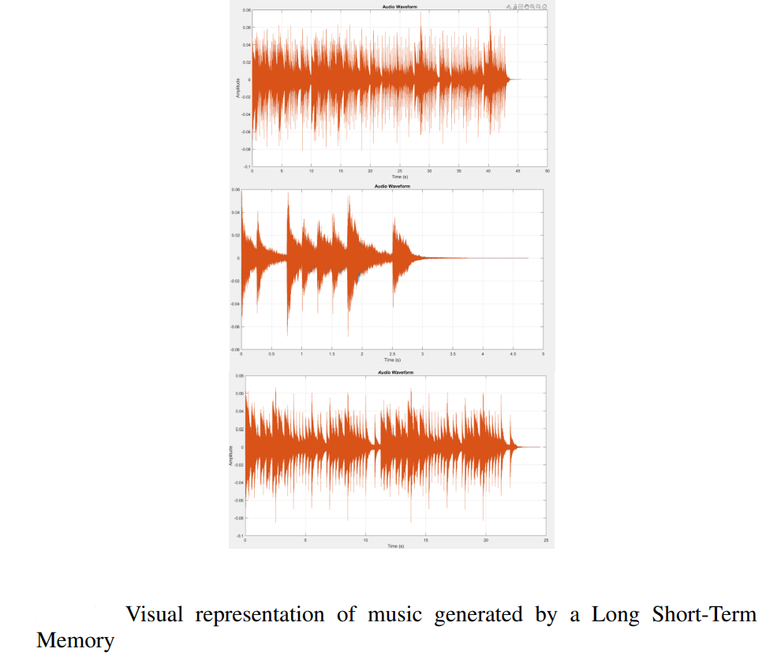
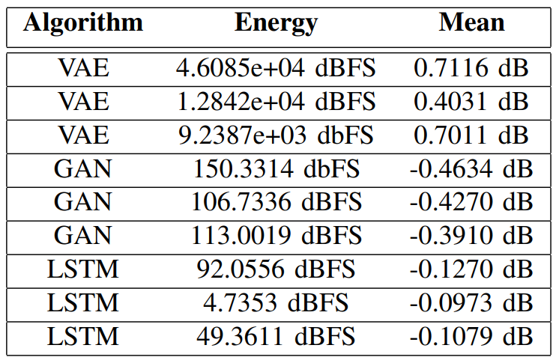
RESULTS AND DISCUSSIONS

Slide 13
CONCLUSION
Music production uses algorithms like Long Short-Term Memory networks (LSTMs), Generative Adversarial Networks (GANs), and Variational Autoencoders (VAEs), with output displayed in MATLAB.
The noise characteristics of the music are accurately depicted. Orange-colored music with decreased noise and energy levels was generated using LSTMs, while GANs produced music with noise levels between LSTMs and VAEs.
Blue-colored VAEs had greater noise levels across the waveforms.
This highlights the importance of algorithm selection in music creation, requiring deliberate decisions based on quality and noise requirements.

Slide 14
REFERENCES
Shah, Falak et al. “LSTM Based Music Generation.” 2019 International Conference on Machine Learning and Data Engineering (iCMLDE) (2019): 48-53.
Maduskar, Advait et al. “Music Generation using Deep Generative Modelling.” 2020 International Conference on Convergence to Digital World - Quo Vadis (ICCDW) (2020): 1-4.
Tang, Jiandong & Yin, Lanqing & Yu, Jinming. (2022). Generation of Western Piano Music Based on Deep Learning. 524-527. 10.1109/ISAIEE57420.2022.00113.
J. Wang, X. Wang and J. Cai, ”Jazz Music Generation Based on Grammar and LSTM,” 2019 11th International Conference on Intelligent Human-Machine Systems and Cybernetics (IHMSC), Hangzhou, China, 2019, pp. 115-120, doi: 10.1109/IHMSC.2019.00035
S. Sajad, S. Dharshika and M. Meleet, ”Music Generation for Novices Using Recurrent Neural Network (RNN),” 2021 International Conference on Innovative Computing, Intelligent Communication and Smart Electrical Systems (ICSES), Chennai, India, 2021, pp. 1-6, doi: 10.1109/ICSES52305.2021.9633906.

Slide 15
Thank you Questions & Discussion

